Slide 1
Connectionist Computing
COMP 30230/41390
Gianluca Pollastri
office: CASL, ground floor Science East.
email: gianluca.pollastri@ucd.ie
Connectionist Computing COMP 30230

Slide 2



Credits
Geoffrey Hinton, University of Toronto.
  borrowed some of his slides for “Neural Networks” and “Computation in Neural Networks” courses.
Ronan Reilly, NUI Maynooth.
  slides from his CS4018.
Paolo Frasconi, University of Florence.
  slides from tutorial on Machine Learning for structured domains.
Connectionist Computing COMP 30230

Slide 3
Lecture notes on Moodle
https://csmoodle.ucd.ie/moodle/course/view.php?id=288
Strictly confidential...
Enrolment key: 30230cc
Connectionist Computing COMP 30230

Slide 4
Books
No book covers large fractions of this course.
Parts of chapters 4, 6, (7), 13 of Tom Mitchell’s “Machine Learning”
Parts of chapter V of Mackay’s “Information Theory, Inference, and Learning Algorithms”, available online at:
http://www.inference.phy.cam.ac.uk/mackay/itprnn/book.html
Chapter 20 of Russell and Norvig’s “Artificial Intelligence: A Modern Approach”, also available at:
http://aima.cs.berkeley.edu/newchap20.pdf
More materials later..
Connectionist Computing COMP 30230

Slide 5
Marking
3 landmark papers to read, and submit a 10-line summary on Moodle about: each worth 6.67%
a small connectionist tool to build and play with: 30%
Final exam: 50%
Connectionist Computing COMP 30230

Slide 6
Backpropagation as message passing
Backpropagation is a schedule for computing weight updates (according to gradient descent) in layered networks of neurons of any depth.
Any layer can be seen as an independent processor passing messages forward and backwards.
Connectionist Computing COMP 30230

Slide 7
Forward, backwards
Forward: digest the input through the weights and produce an output.
Backwards: digest deltas from the layer above, generate new deltas and pass them to the layer below.
During backwards weight updates are also computed.
A layer doesn’t need to know anything about the network topology to do this. Excellent object.
Connectionist Computing COMP 30230

Slide 8
Backpropagation
Works on any Direct Acyclic Graph of continuous units: no binary-threshold (can’t compute f’()).
Loops acceptable only with time delays, we’ll see this later.
Very efficient:
  O(|w|)
  Large networks possible (~10⁴-10⁶ weights reported in many real world applications)
Connectionist Computing COMP 30230

Slide 9
Expressive power
Shortly:
  A single hidden-layer network can approximate every input-output mapping (provided enough units in the hidden layer)
Connectionist Computing COMP 30230

Slide 10
VC dimension: Single and Multi-Layer Perceptrons
SLP performs linear separation. If there are n inputs
  VC(SLP) = n+1.
MLP is more powerful:
  VC(MLP) = 2(n+1) M (1+logM)
Connectionist Computing COMP 30230

Slide 11
MLP applications: matching words and sounds
Sejnowski and Rosenberg, “NETtalk, a parallel network that learns to read aloud”, Cognitive Science, 14, 179-211 (1986)
Teaching an MLP how to pronounce English by backprop.
The network was given a stream of words, with the corresponding phonemes.
Once the network had learned, it was possible to make it read.
Connectionist Computing COMP 30230

Slide 12
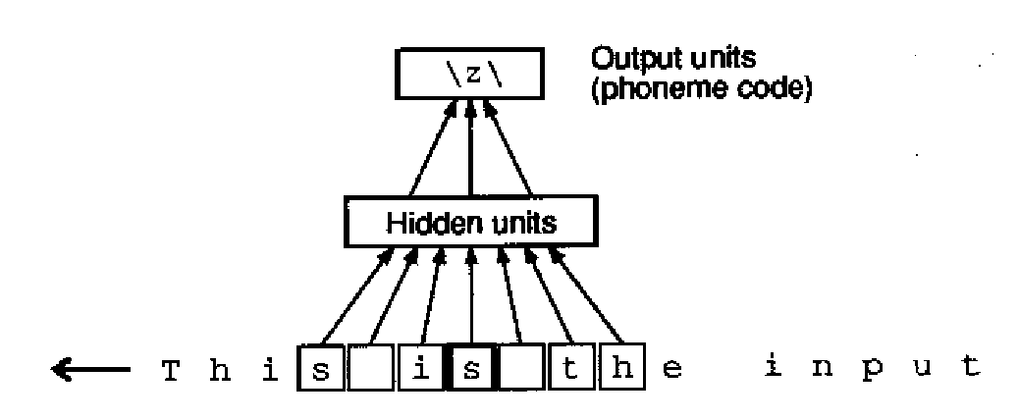
The network
203x80x26 network
input is sliding sequence of 7 characters
80 hidden units
Connectionist Computing COMP 30230

Slide 13
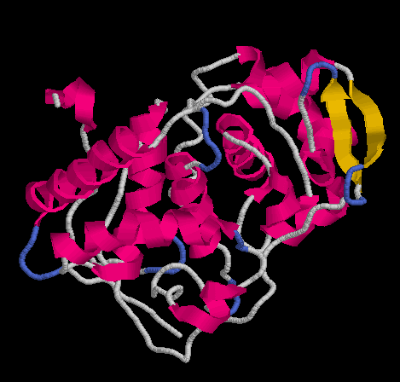
MLP applications: protein secondary structure prediction
Proteins are strings:
FEFHGYARSGVIMNDSGASTKS
GAYITPAGETGGAIGRLGNQAD
TYVEMNLEHKQTLDNG
Structures too:
Connectionist Computing COMP 30230

Slide 14
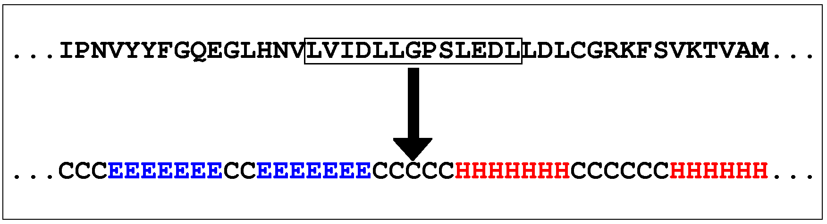
by NETtalk
Qian and Sejnowski 1988.
They used NETtalk to predict it
Sliding window, stacked networks.
Connectionist Computing COMP 30230

Slide 15
results
64% correct prediction
not great but better than the other methods
neural networks are nowadays the prime method for SS prediction
Connectionist Computing COMP 30230

Slide 16
MLP applications: handwritten digit recognition
“Hand-written digit recognition with a back-propagation network”, Le Cun et al. 1990
Multi-layer perceptron applied to handwritten digits.
Relatively little non-connectionist preprocessing: digits split, centred, normalised.
Connectionist Computing COMP 30230

Slide 17
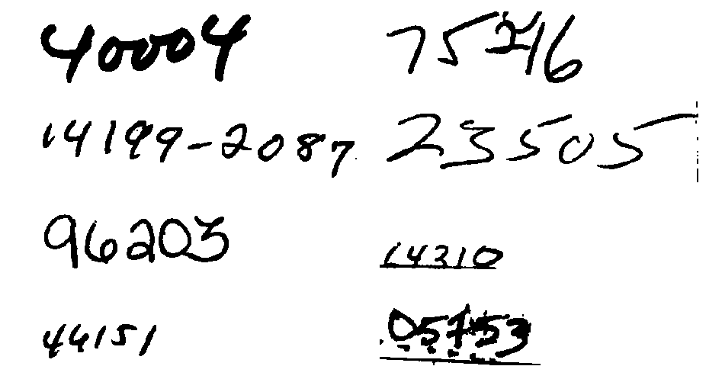
The sets
9298 digits from letters passing through the Buffalo office of the US PS + 3349 printed digits from 35 fonts.
Training set: 7291+2549
Test set: 2007+700
Connectionist Computing COMP 30230

Slide 18
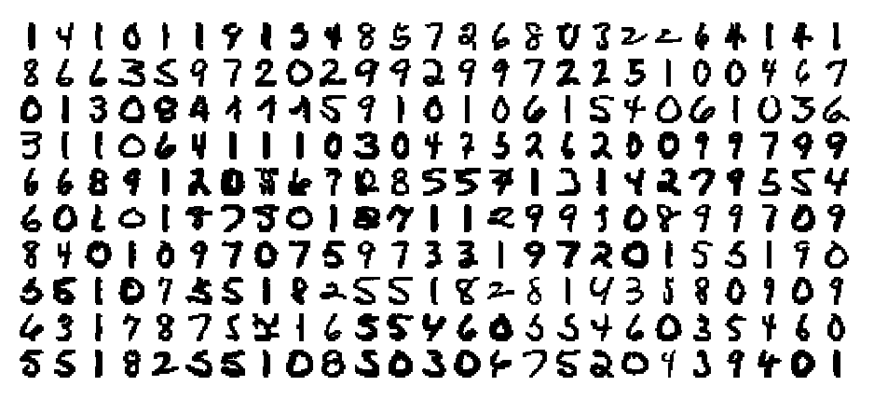
preprocessing
Enough to obtain digits in this format, each one is a 16x16 greyscale image:
Connectionist Computing COMP 30230

Slide 19
The network
In theory one could simply feed the image into a Multi-layer perceptron with M hidden units.
The input would be an array of 16x16=256 real values, the output an array of ten values, one for each class (0,1,..9).
This means (256+1)M+(M+1)10=267M+10 weights. If M=50 -> 13360 weights, fairly large for 10k examples (and difficult to train in 1990).
Connectionist Computing COMP 30230

Slide 20
The network
Le Cun et al. design a network with:
partial connectivity, i.e. not all the units in layer i are connected to all the units in layer i+1.
weight sharing, i.e. different parts of the networks are forced to use the same weights.
Connectionist Computing COMP 30230

Slide 21
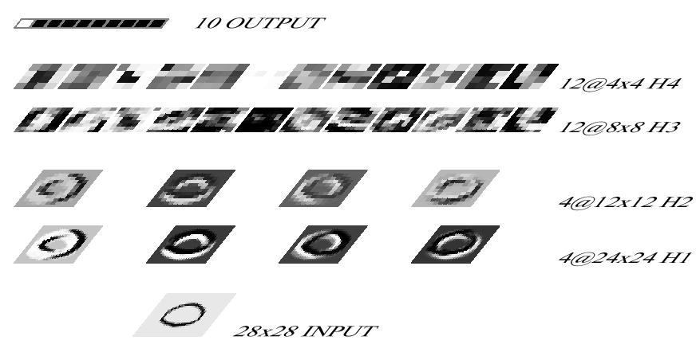
deep network
4 hidden layers:
Connectionist Computing COMP 30230

Slide 22
Feature maps
Hidden layers 1 and 3 implement feature maps.
Layer 1 Input is the 16x16 image, with borders added for technical reasons -> 28x28. Output is composed by 4 maps of 24x24 units. This is really implemented with 4 neurons, each taking 5x5 inputs, each replicated in each possible position on the input map.
This sounds complicated but is fairly easy: instead of a (28x28)->(24x24x4) full connectivity only 5x5 inputs are connected to each output unit. Not only, but there are just 4 neurons/sets of weights (weight sharing).
So, a (5x5)->4 full connectivity that sweeps the whole input. Only 104 weights including biases!
Connectionist Computing COMP 30230

Slide 23
Averaging/subsampling layer
Hidden layers 2 and 4 implement averaging/subsampling stages.
Layer 2 : 24x24x4 -> 12x12x4
This is performed using 4 units, each one doing a 2x2->1 mapping. Weights are constrained to be all the same.
Connectionist Computing COMP 30230

Slide 24
layers 3, 4 and 5
Layer 3 : more feature maps. 12 8x8 maps. Each map is composed by a neuron (always the same) mapping a 5x5 area into a unit.
Layer 4: Same as layer 2. (8x8x12) -> (4x4x12)
Layer 5: 10 output units fully connected to layer 4. This is where most weights are.
Connectionist Computing COMP 30230

Slide 25
overall
5 layers, position invariance encoded in the architecture, a lot of weights shared.
~100k connections -> 2k independent parameters. every weight is shared on average by 50 connections.
Training complexity is still o(100k) though.
Connectionist Computing COMP 30230

Slide 26
Training the network
Training is by gradient descent, using backpropagation.
For each copy j of a shared weight there will be a Δwj. They are simply added together.
Connectionist Computing COMP 30230

Slide 27
Results
After 30 epochs the error on the training set was 1.1% and the squared error 0.017.
On the test set: 3.4% and 0.024
To get 1% error: 5.7% rejection (9% on just handwritten)
A lot of these were actually caused by preprocessing. Some of those that weren’t, were ambiguous even to humans.
Connectionist Computing COMP 30230

